Slide 1
Micro Frontend Architecture -----------------------------------
Extending the micro services idea into frontend UI development.
Building a modern webapp with multiple teams.
Ganapathi G N

Slide 2

About me
Ganapathi Natarajan
Application Developer / Individual contributor
Lead UI developer cum UI architect (12+ years exp)
Transitioned into Full stack developer with Java spring boot
Specific to Micro front with Single SPA & module federation
Continues learner and keep exploring AWS & Dev Ops

Slide 3
Micro Frontends (MFE)
Micro frontends apply the same principles to the front end, breaking down a web application into smaller, autonomous modules or functions. Each module can be developed independently, providing frontend teams with a level of flexibility and speed akin to what microservices offer to their backend counterparts.
Recent trend of breaking up frontend monoliths into many smaller, more manageable pieces, and how this architecture can increase the effectiveness and efficiency of teams working on frontend code.
The idea behind Micro Frontends is to think about a website or web app as a composition of features which are owned by independent teams. Each team has a distinct area of business or mission it cares about and specializes in. A team is cross functional and develops its features end-to-end, from database to user interface.

Slide 4
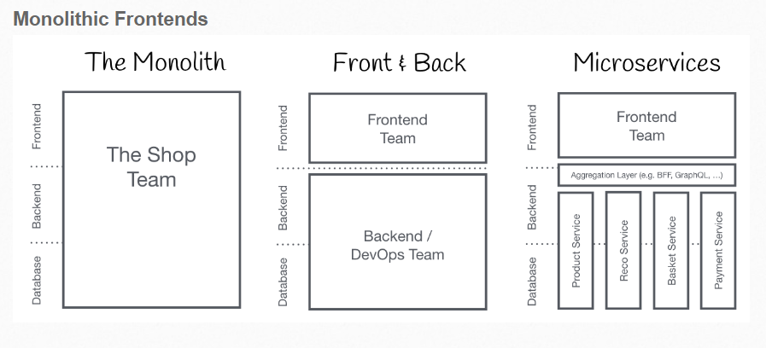
Monolithic Frontends

Slide 5
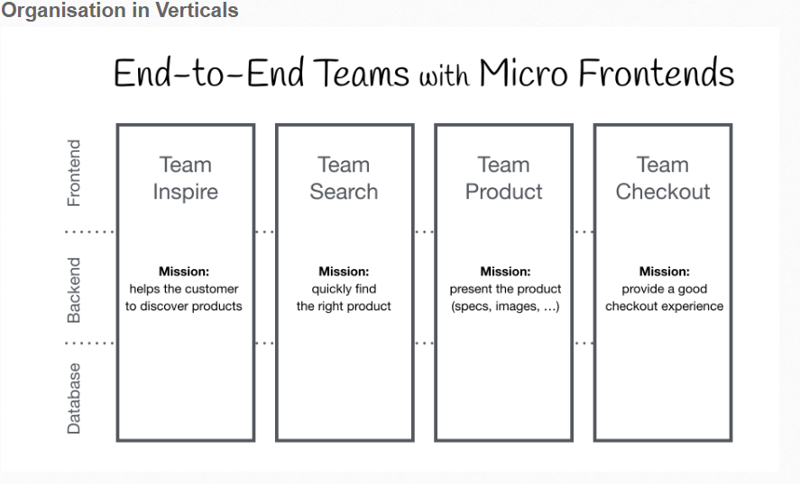
Micro Frontend UI Apps

Slide 6
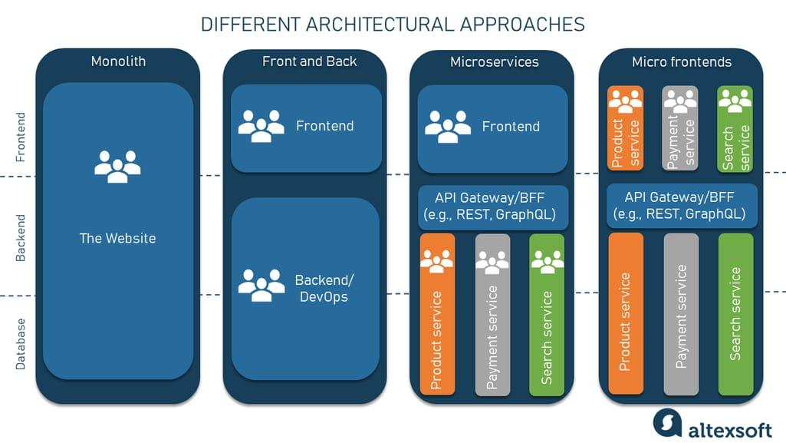
Transition from full stack to micro front ends

Slide 7
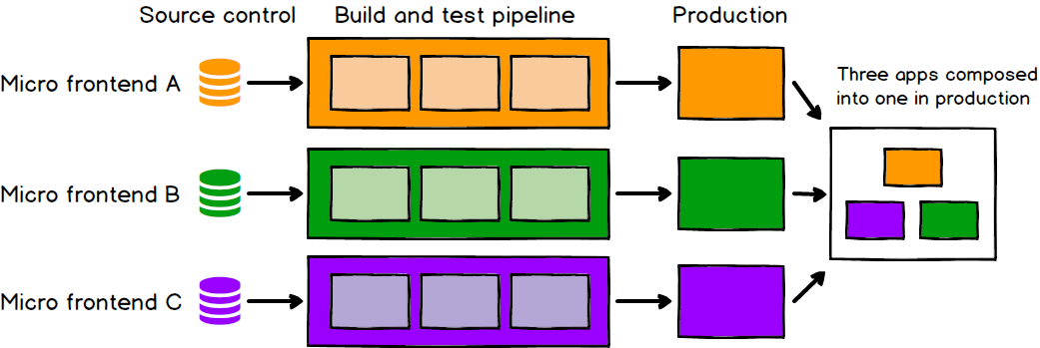

Slide 8
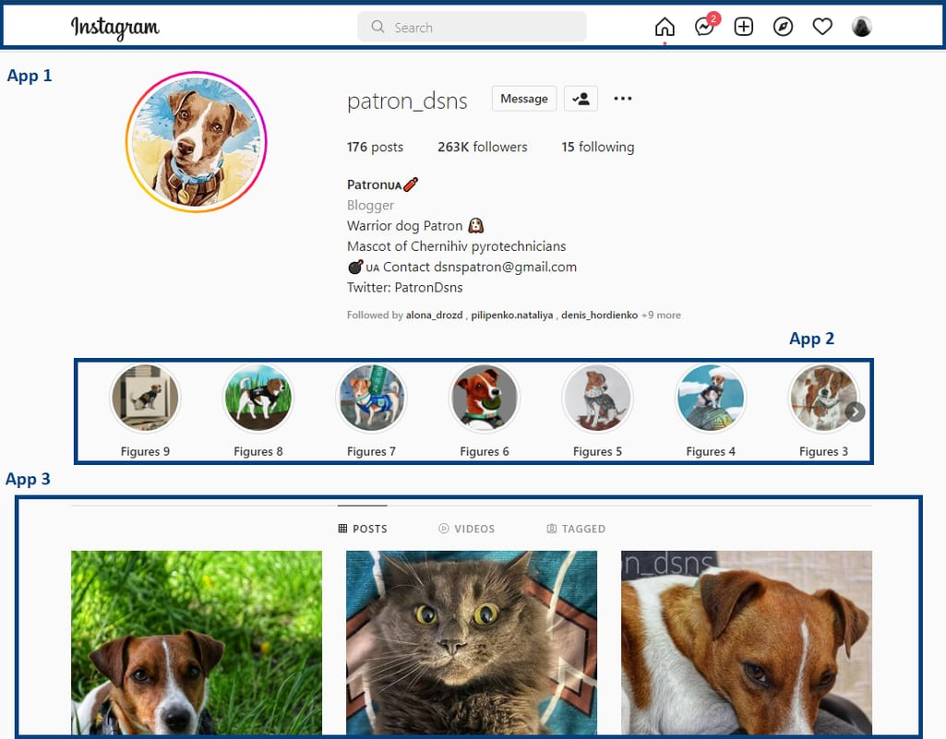
Divide the SPA app into micro UI apps

Slide 9
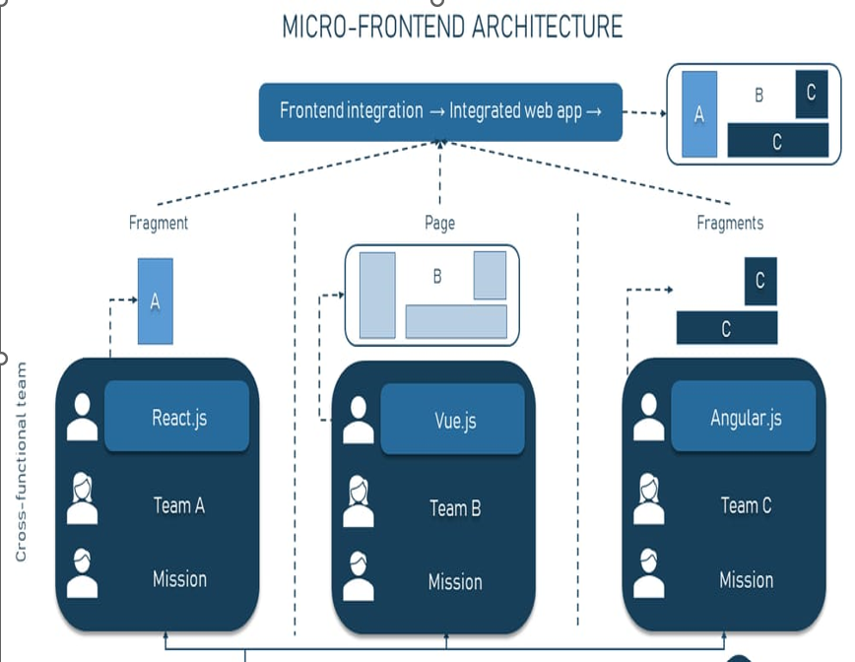
Single SPA ( Polyglot) Micro Frontend Architecture

Slide 10
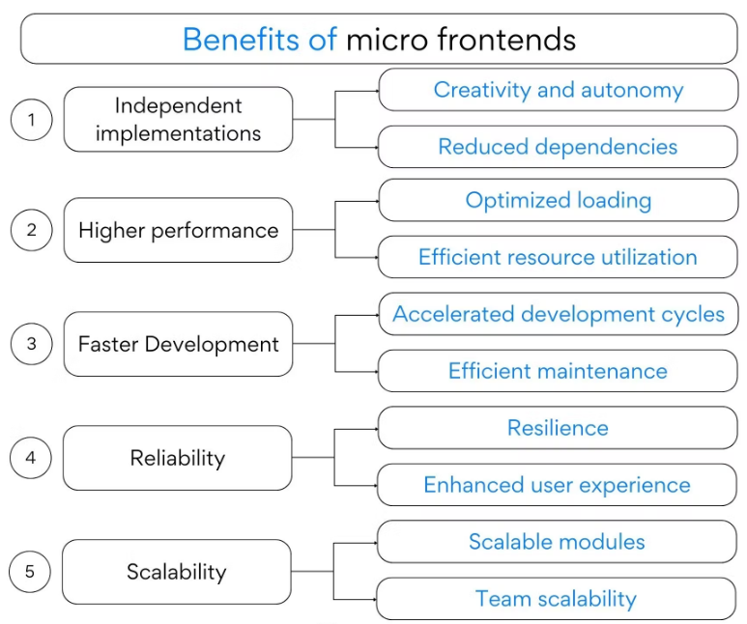
Benefits behind Micro frontends

Slide 11
Benefits behind Micro frontends –part2
Simple, decoupled codebases
Autonomous teams
The source code for each individual micro frontend will by definition be much smaller than the source code of a single monolithic frontend. These smaller codebases tend to be simpler and easier for developers to work with. In particular, we avoid the complexity arising from unintentional and inappropriate coupling between components that should not know about each other.
As a higher-order benefit of decoupling both our codebases and our release cycles, we get a long way towards having fully independent teams, who can own a section of a product from ideation through to production and beyond. Teams can have full ownership of everything they need to deliver value to customers, which enables them to move quickly and effectively. For this to work, our teams need to be formed around vertical slices of business functionality, rather than around technical capabilities.

Slide 12
Categories of Micro front ends – 2 types
Run time Micro frontends
Build time Micro frontends
Any change in one micro frontend can be taken to production without worrying about other micro frontends aka Independent Deployments.
Each team is free to consider the tech choices within their micro frontend aka autonomous teams.
There is less coupling between the micro frontends and more cohesion within the micro frontend aka Modular Codebase.
Building npm packages and using those inside the frontend application for eternity now. Build time composition of Micro Frontends is nothing but creating micro frontend modules which can run independently but are published as npm packages instead of deployed as a javascript bundle. These modules can then be installed as an npm dependency inside a container application and rendered wherever required

Slide 13
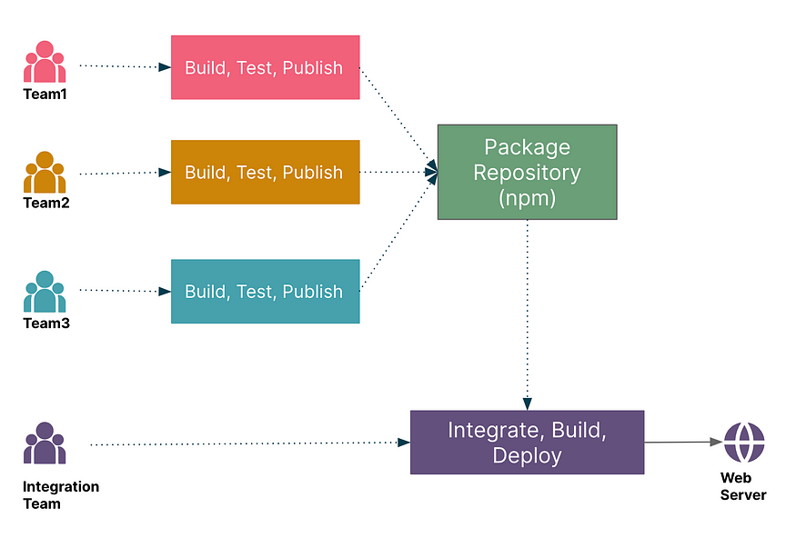
Build time Micro frontend e.g Datepicker, Ag-grid, material ui, bootstrap, tailwind

Slide 14
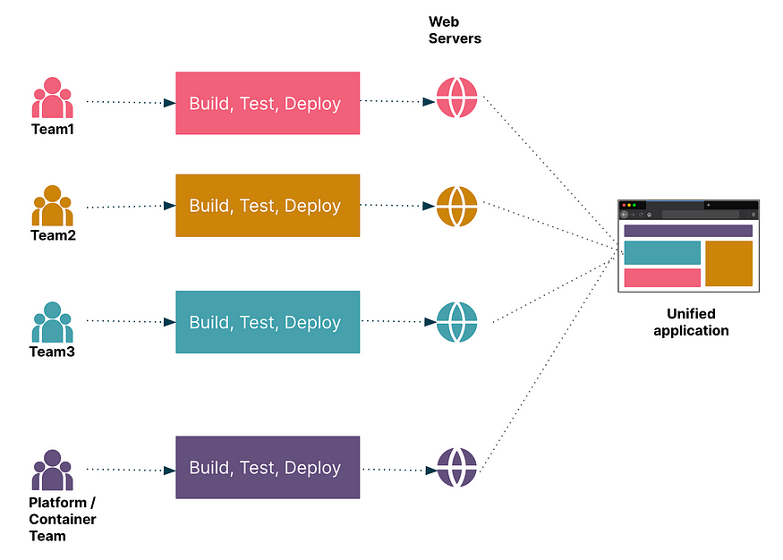
Run time Micro frontend e.g Home page, Service page, contact page

Slide 15
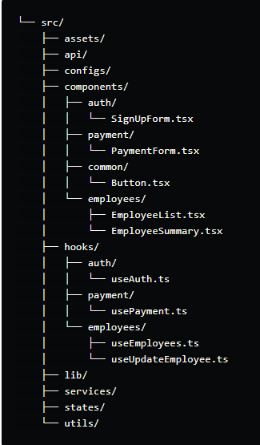
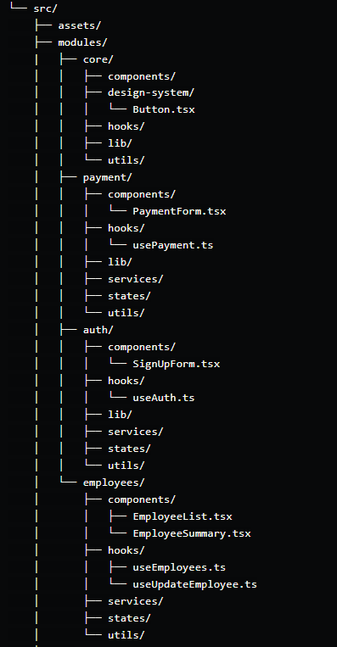
React Project Folder structure and best practices

Slide 16
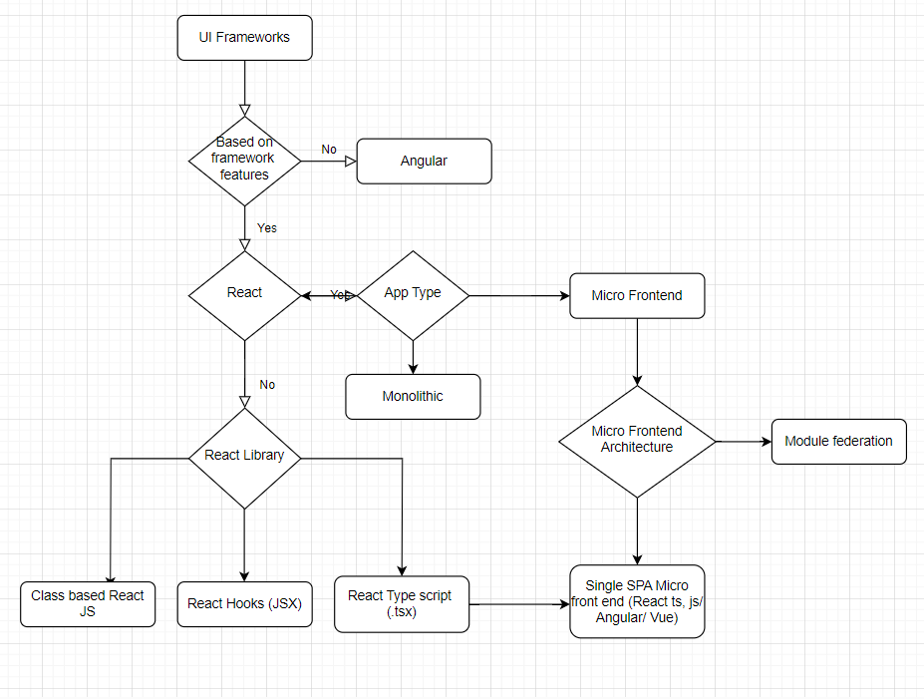

Slide 17
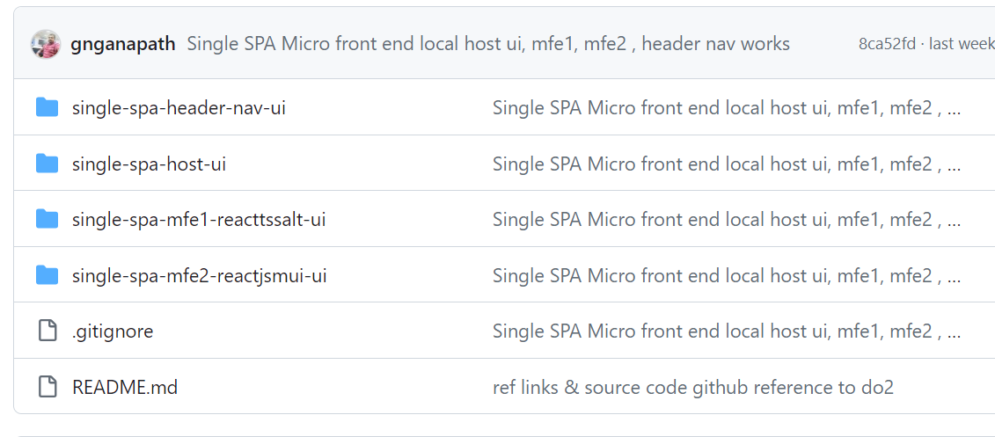
Demo & Queries
Reference Links
https://micro-frontends.org/
https://martinfowler.com/articles/micro-frontends.html
https://www.altexsoft.com/blog/micro-frontend/
https://www.turing.com/blog/micro-frontends-what-are-they-when-to-use-them#_evolution_of_micro_frontends
https://sharvishi9118.medium.com/how-to-compose-micro-frontends-at-build-time-c5e484a40e10
https://blog.bitsrc.io/you-dont-need-another-library-to-compose-micro-frontends-at-run-time-e803077ade67
https://dev.to/itswillt/folder-structures-in-react-projects-3dp8

